Slide 1

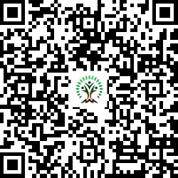


IONIQ Forest
Grid – C Zones 1 -10

Slide 2
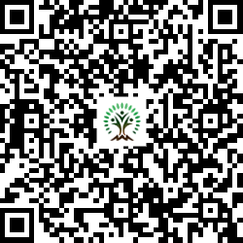
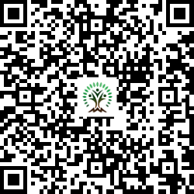
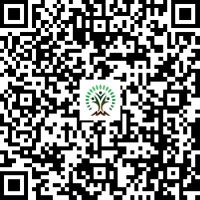
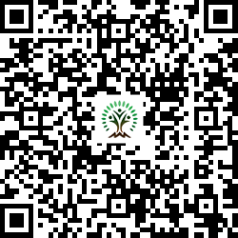
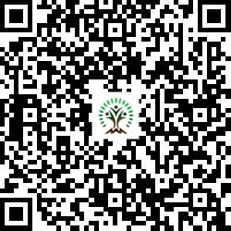
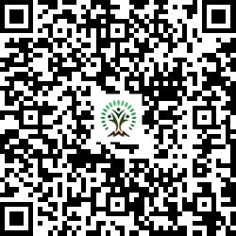
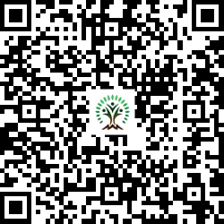
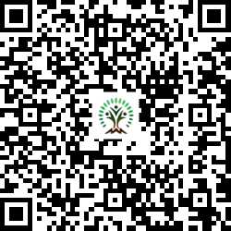
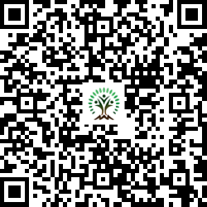
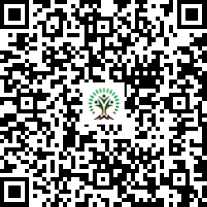
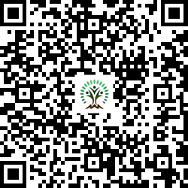
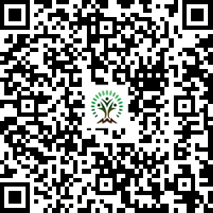
Sr. No. | Scientific Name | Common Name | QR Code
1 | Aegle marmelos | Wood Apple
2 | Azadirachta indica | Neem Tree
3 | Dalbergia sissoo | Indian rosewood
4 | Lagerstroemia speciosa | Pride of India
5 | Mimusops elengi | Spanish cherry
6 | Neolamarckia cadamba | Burrflower tree
7 | Phyllanthus emblica | Indian gooseberry
Sr. No. | Scientific Name | Common Name | QR Code
8 | Pongamia pinnata | Indian Beech Tree
9 | Psidium guajava | Guava
10 | Syzygium cumini | Java plum
11 | Terminalia arjuna | White Murdah
12 | Toona ciliata | Indian mahogany

